Slide 2

Unit 10: Adding Computations, Processes, and Validations

Slide 3
Lesson Objectives
After completing this lesson, you should be able to:
Explain page rendering and page processing
Create computations
Create page processes
Create validations
Create branches
Notes:
In this lesson, you learn the difference between page rendering and page processing. You learn how to create and use page computations, processes, and validations in your application. This lesson also covers how to create and use branches in your application.

Slide 4
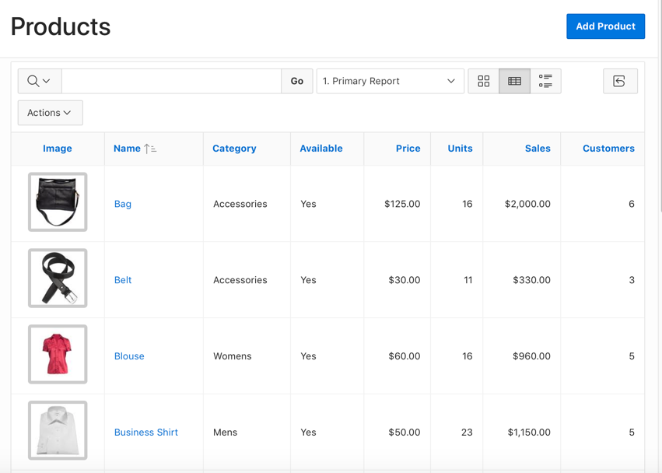
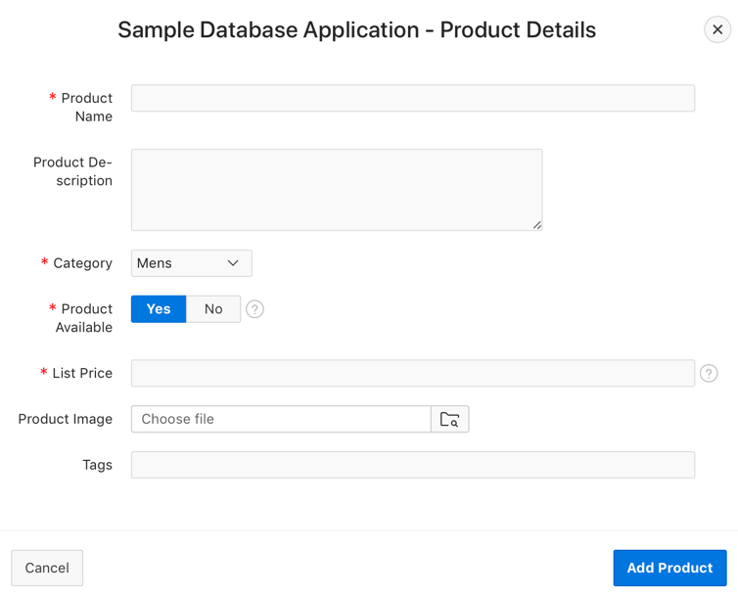
Understanding Page Rendering and Page Processing
When you run an application, Application Express engine relies on two processes:
Show Page (Page Rendering)
Accept Page (Page Processing)
Show Page
Accept Page
Notes:
When you create an application in App Builder, you link pages together using tabs, navigation menus, buttons, or hypertext links. Each page can have buttons and items and can include application logic. You can branch from one page to the next using conditional navigation, perform calculations and validations, and display reports, calendars, and charts. You can generate reports, charts, and forms using built-in wizards, static HTML, or deliver more custom rendering with PL/SQL programming.
The Application Express engine dynamically renders and processes pages based on data stored in Oracle database tables. To view a rendered version of your application, you request it from the Application Express engine with a URL. When you run an application, the Application Express engine relies on two processes:
Show Page is the page rendering process. It assembles all the page attributes (including regions, items, and buttons) into a viewable HTML page.
Accept Page performs page processing. It performs any computations, validations, processes, and branching.
When you request a page using a URL, the engine is running Show Page. When you submit a page, the Application Express engine is running Accept Page or performing page processing during which it saves the submitted values in the session cache and then performs any computations, validations, or processes.

Slide 5
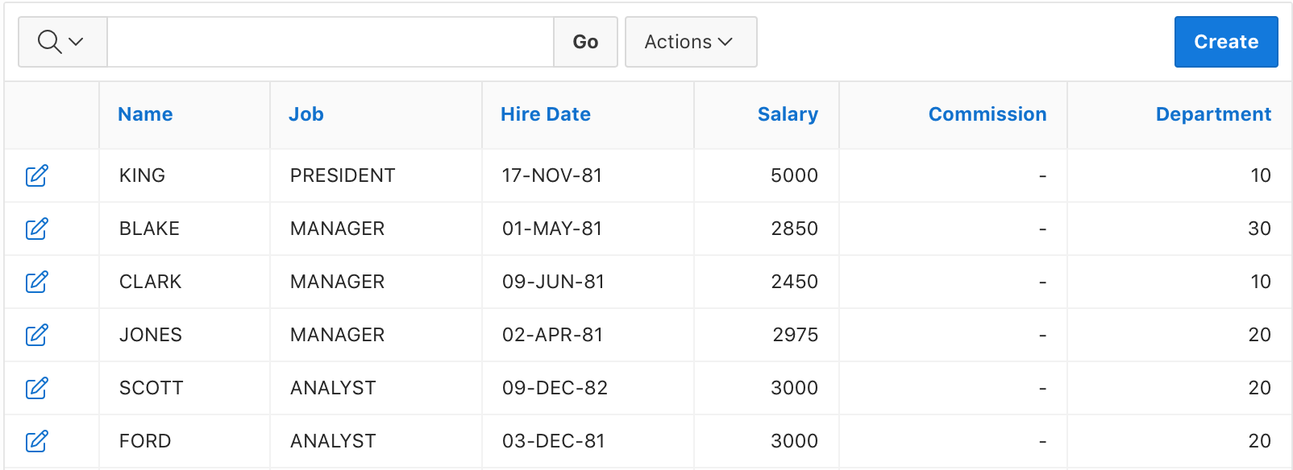
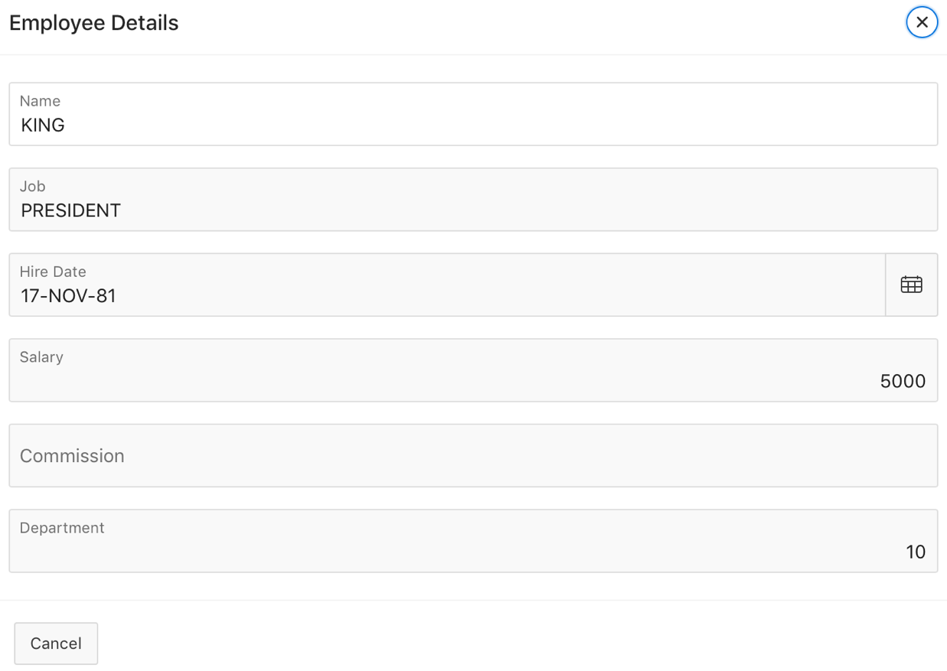
Page Rendering: Example
Notes:
The slide shows an example of page rendering. In this example, you see the Employees report. When you click the Edit icon in the report, the page is submitted and a branch to the Employee Details form dialog page is invoked. When you click the Cancel button on the Employee Details form page, you are redirected to the Employees report page again. In this example, nothing is submitted, and so there is no page processing.

Slide 6
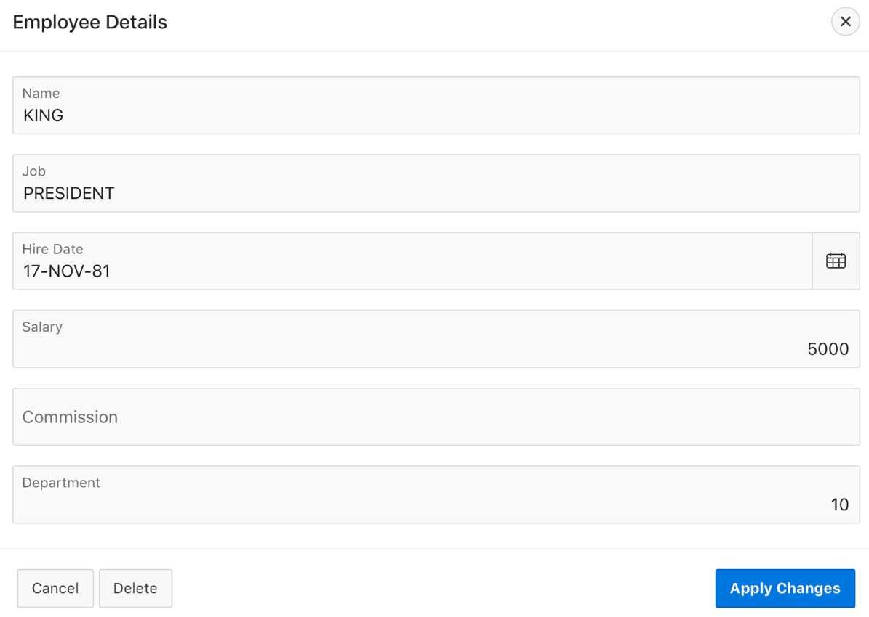
Page Processing: Example
Notes:
The slide example describes page processing. In this example, you see the Employee Details form. When the items in the form dialog are updated and the user presses Apply Changes the page process is executed and the items from the page are used to update and commit the underlying table in the Oracle Database.

Slide 7
What is a Computation?
A computation is a logic that assigns values to a single item
Two types of computations:
Application Computation
Page Computation
A page computation assigns a value to an identified item when a page is displayed or submitted (rendered and processed).
Notes:
A page computation assigns a value to an identified item when a page is displayed or submitted (rendered and processed). You can also use application-level computations to assign values to items. Most page-level computations populate page items. In contrast, most application-level computations populate application items.
Application Computations are units of logic that set the value of a single page or application-level item and are run at the same point across multiple pages in an application. Like page-level computation, application computations can be based on static values, item values, PL/SQL, or SQL. A common use of an application item is to store the value of the last page viewed in the application. By storing the value in an item, you can add a back button and then redirect the user to the page number captured by the computation. This type of computation works well, for example, when you need to enable users to back out of an error page.
Computations compute how data is to be displayed for you or how data is to be handled after submitting. This lesson covers page computations. Examples of page computations:
Page-rendering computation: You want to retrieve and display value of for example, total salary from the database when a report is displayed.
Page-processing computation: A form page contains fields for entering phone numbers. The phone number is stored in one database column. However, the data entry form breaks the phone number into three components: area code, prefix, and line number. In this example, the page items are called P10_AREA_CODE, P10_PREFIX, and P10_LINE_NUMBER. Next, suppose you need to combine the values stored in these items into a single string. You could accomplish this by using a computation and store the combined values in an item called P10_PHONE_NUMBER.

Slide 8
Creating a Page Computation: Steps
Navigate to the appropriate page in Page Designer.
In the Rendering tab, expand the Pre-Rendering or Post-Rendering node and locate where the computation should be.
Right-click the location and select Create Computation..
Edit the attributes in the property editor
Click Save
Notes:
You create a page computation by running the Create Page Computation Wizard. For each computation, specify the item for which you are creating the computation and a computation type.
To create a page computation, perform the following steps:
Navigate to the appropriate page in Page Designer.
In the Rendering tab, expand the Pre-Rendering or Post-Rendering node and locate where the computation should be.
Right-click the location and select Create Computation. The Property Editor displays Computation attributes. In the Property Editor attributes are organized in to groups. To find a group or attribute, enter keywords in the Filter Properties field. The Property Editor displays the group or attributes. Or, you can click Go to Group and select the group.
Edit the following attributes:
Identification, Item Name - Enter the page or application item populated by this computation.
Execution Options, Sequence - Specify the sequence for this computation. The sequence determines the order of execution.
Execution Options, Point - Select at what point in page rendering or processing this computation is executed. The most typical computation point is After Submit.
Computation, Type - Select a computation type. To view a list of options, see Help.
Click Save.
You control when a computation executes using the Sequence and Computation Point attributes. The Sequence attribute determines the order of evaluation. The Computation Point attribute enables you to specify the point at which to execute the computation the item. For example, selecting On New Instance executes the computation when a new session (or instance) is generated. After you specify the Sequence and Computation Point, under Source, enter an expression or query in the Computation field to compute an item's value. In the event a computation fails, you can optionally define an error message in the Computation Error Message field.

Slide 9
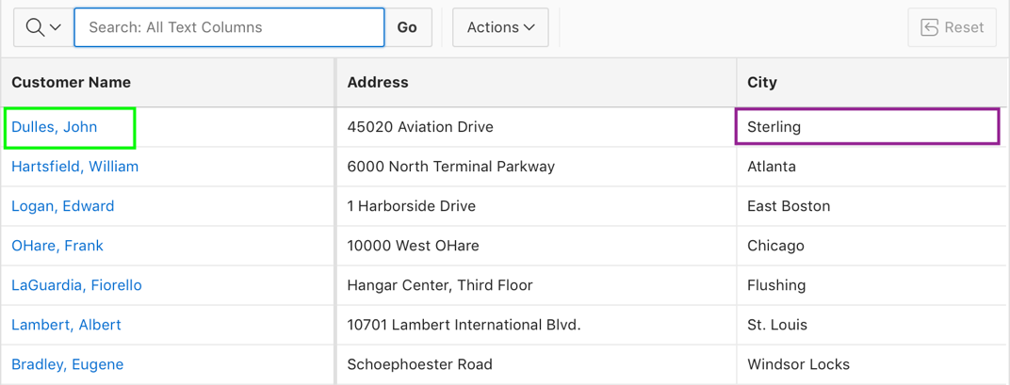
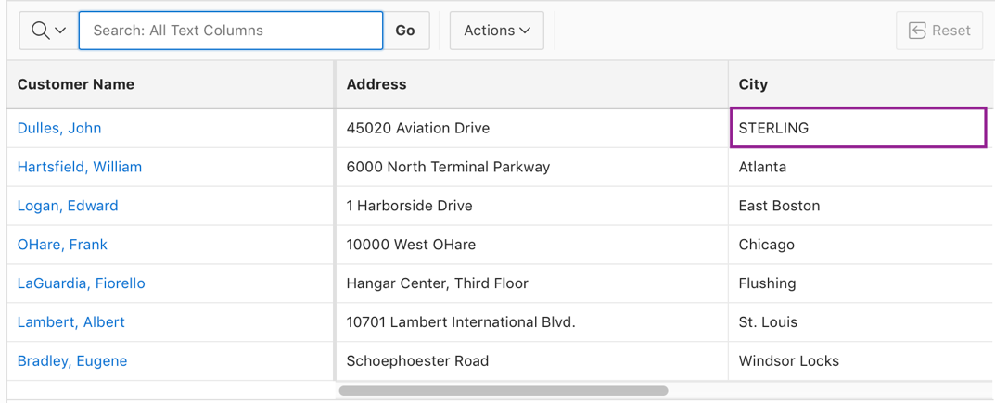
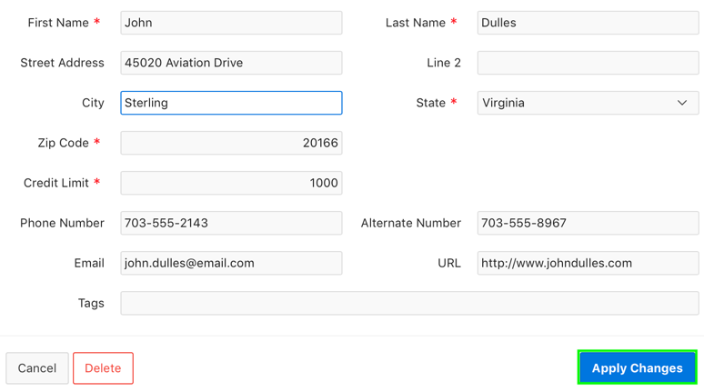
Creating a Page Computation: Example
1
3
2
Notes:
In the slide example:
Navigate to the Customers report and edit a record by clicking a customer name. Notice that the value for City is in mixed case.
Click Apply Changes.
The Customers report is displayed. Notice that the value for City is in uppercase now.
To ensure that the value you enter for City should be stored in the database in uppercase, you create a page computation. As you click the Apply Changes button in the slide example, this computation is invoked. See the next slide for steps to create this computation.

Slide 10
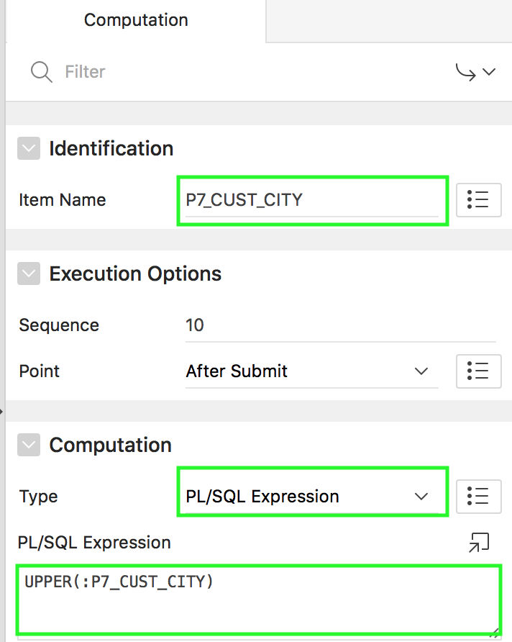
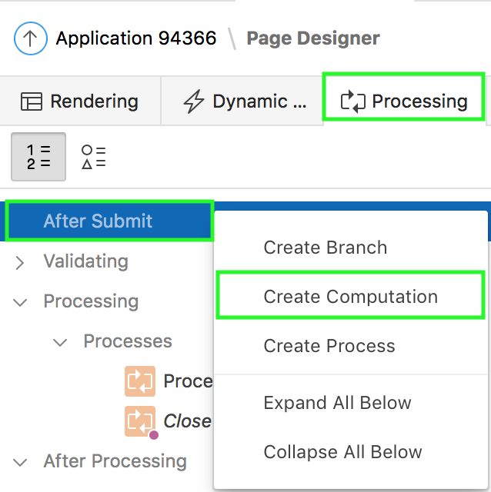
Creating a Page Computation: Example
2
1
Notes:
The slide shows an example of an After Submit PL/SQL Express computation. In this example, you want to specify that P<n>_CUST_CITY that is entered should be stored in the database in uppercase. Perform the following steps:
Navigate to page designer and click Processing. Right-click the After Submit node and select Create Computation.
In the Computation property editor:
Select the Item Name and select a computation type. For example, in the slide, select P7_CUST_CITY item and select PL/SQL Expression for Computation > Type.
Specify the PL/SQL expression. Click Save.
The Computation is created and is now listed under the Computations node.

Slide 11
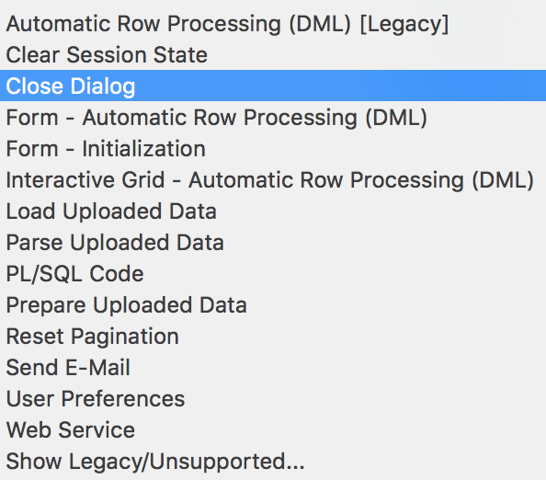
What is a Page Process?
A page process is a specific event that runs when a page is loaded or submitted
Process Types
Notes:
A page process performs an action at a specified point during the rendering or submission of the page. For example, you can create a page process to execute logic or to make a call to the Application Express engine. A page process is a unit of logic that runs when a specific event occurs, such as loading or submitting a page. You can apply conditions to control when the process executes.
Application processes are blocks of PL/SQL logic that are set to run at specific points using processes from multiple pages of an application. By default, application processes execute at the same point for every page in the application.
From a functional perspective, there is no difference between page-level and application-level processes. The difference between these two process types is where the process is defined, that is at the page-level or at the application level.
The slide shows different process types supported by Application Express. Each process type has a different use.
Automatic Row Processing (DML): Process to insert, update, or delete records into a single database table or updateable view. This process is used to process form items with a source of Type Database Column. Attributes entered for this process should correlate with the attributes entered in the Automatic Row Fetch process.
Clear Session State: Process to clear session state stored within Application Express
Close Dialog: Process to close the current modal or non-modal dialog page.
Form - Automatic Row Processing (DML): Process to insert, update, or delete a form region row(s).
Form- Initialization: Process to initialize form region items. Initialization can either be fetching data from the region source, using the primary key value(s) or simple initialization of the form region items.
Interactive Grid - Automatic Row Processing (DML): Process to insert, update, or delete Interactive Grid rows.
Load Uploaded Data: Process to load the parsed spreadsheet data into an existing table or view. This process type is generated by the Create Page Wizard for Data Loading.
Parse Uploaded Data: Process to parse the prepared spreadsheet data in preparation for loading into an existing table. This process type is generated by the Create Page Wizard for Data Loading.
PL/SQL Code: Process to execute PL/SQL code.
Prepare Uploaded Data: Process to prepare spreadsheet data for uploading into an existing table. This process type is generated by the Create Page Wizard for Data Loading.
Reset Pagination: Process to reset pagination of reports on the current page.
Send E-Mail: Process to send an email, and optionally one or more attachments, from the application.
User Preferences: Process to set User Preferences for the end user.
Web Service: Process to consume the specified Web service.
Depending on your application configuration, you may also have additional process type plug-ins available here. These display as <My Plug-in> [Plug-in].

Slide 12
Creating a Page Process: Steps
In either the Rendering or Processing tab, locate the node where the process will occur. Right-click and select Create Process.
Specify the name of the process and process type to execute
Under Settings, edit the appropriate attributes
Under Execution options, specify the sequence, and point of execution of the process
Specify the success and error messages
Click Save
Notes:
To create a page process, perform the following steps:
View the page in Page Designer. In either the Rendering or Processing tab, locate the node where the process will occur. Right-click and select Create Process.
Process attributes display in the Property Editor. Attributes are organized in groups. Under Identification, specify the following:
Name: Name of the process
Type: Process type to execute. The Type you select determines what Setting attributes display.
Under Settings, edit the appropriate attributes
Under Execution Options, specify the following:
Sequence: Sequence for this process. The sequence determines the order of execution.
Point: Point at which this process is executed
Run Process: Frequency that this process is executed
Under Success Message, for Error Message, enter the success message for this process. If the process runs and does not generate an error, then this process success message displays in the notification section of the resulting page displayed.
Under Error, specify the following:
Error Message: Error message for this process. This message displays if an unhandled exception is raised. After any error processing stops, a rollback is issued and an error message displays.
Display Location: Location where this process error message displays, when the process fails to complete successfully.
Click Save.

Slide 13
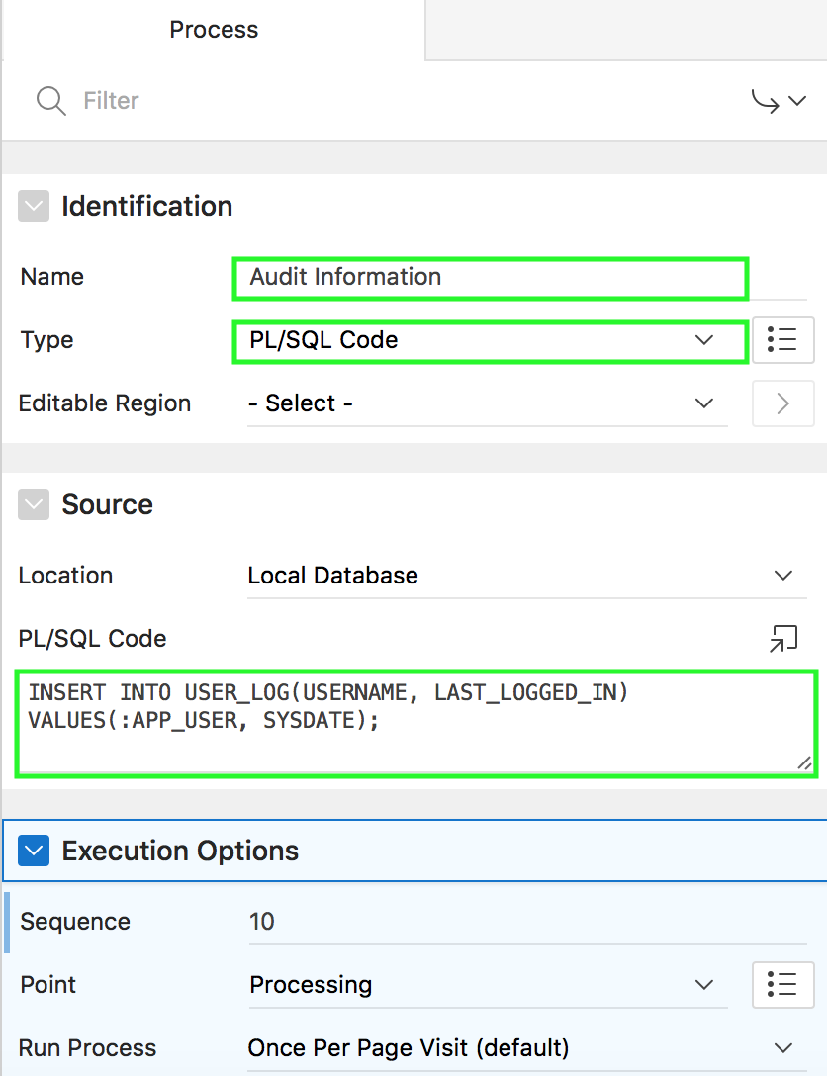
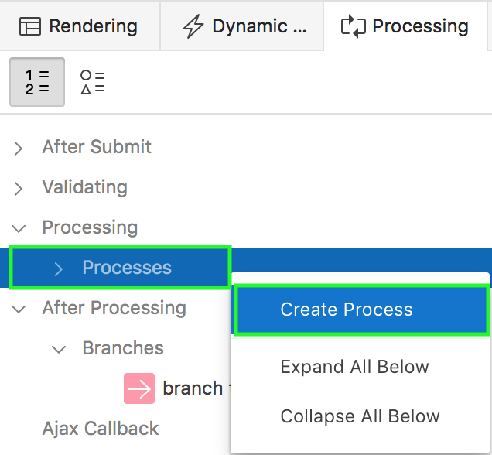
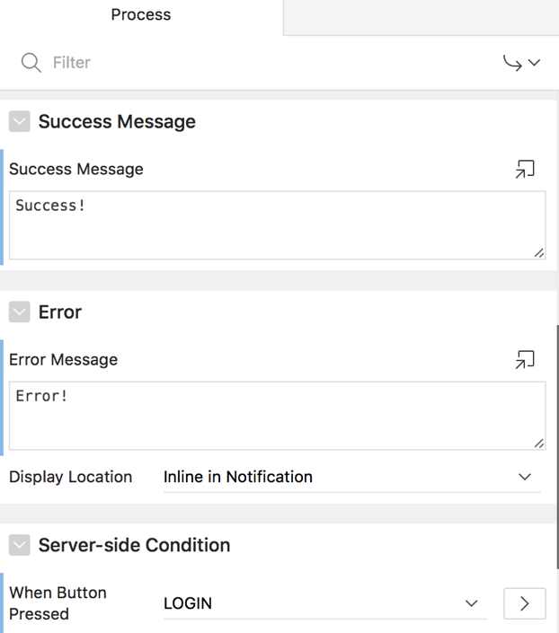
Creating an On Submit Process
2
3
1
Notes:
You want to store details of application users’ usernames and last logged in details in the USER_LOG table. The slide example shows how to achieve this by creating an On Submit page process.
To create the an On Submit page process, perform the following steps:
In the Processing tab, right-click Processes and select Create Process.
In the Process property editor:
Specify the name of the process and process type to execute. For example, in the slide select PL/SQL Code for Type.
Under Source, you can choose the location where the process is executed. The location can be either the Local Database or Remote Database where the connection is defined using REST Enabled SQL. For PL/SQL Code, enter the PL/SQL code in the text area. In the slide example, you enter an INSERT statement to insert the application username and the user logged in date and time in to the USER_LOG table.
Under Execution options, specify the sequence, and point of execution of the process. The point of execution should show Processing.
Specify the success and error messages. You can also specify a condition for executing the process, for example, when the Login button is pressed.
Click Save. The page process is created.

Slide 14
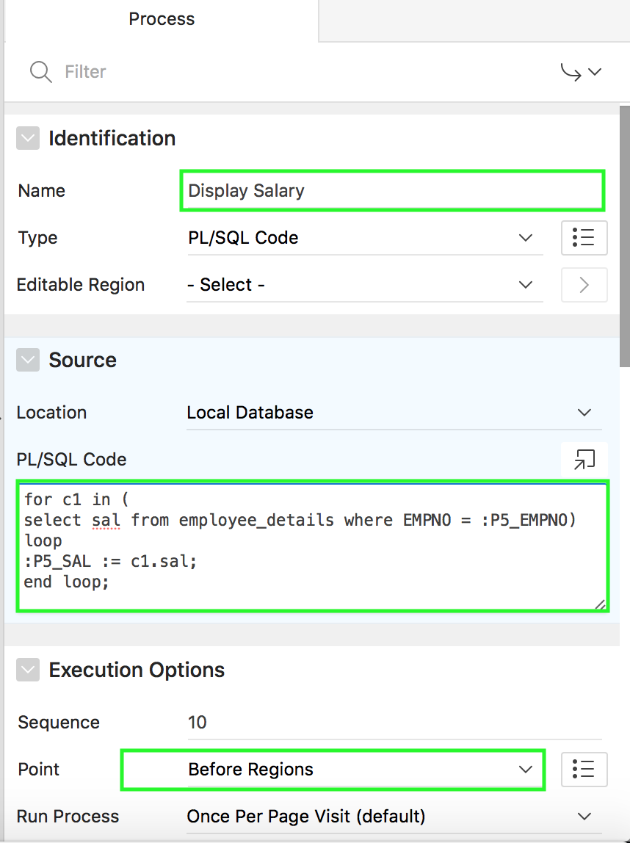
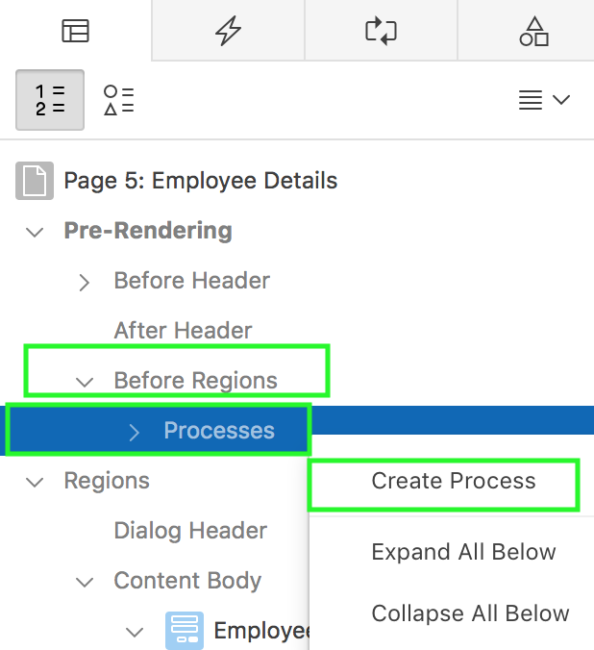
Creating an On Load Process
2
1
Notes:
In the slide example, the Employee Details form page doesn’t include a salary field. However, when you select an employee, you want to review the salary details as Display Only. To achieve this, first you create a Display Only item, P<n>_SAL on the Employee Details page. Then, you create an On Load process that is executed Before Regions. This process retrieves salary value from the database table and loads it into P<n>_SAL item. Therefore, when you click an employee record, you see Salary as Display Only.
To create an On Load page process, perform the following steps:
In the Rendering tab, right-click Before Regions and select Create Process.
In the Process property editor:
Specify the name of the process and process type to execute. For example, in the slide select PL/SQL Code for Type.
Under Source, you can choose the location where the process is executed. The location can be either the Local Database or Remote Database where the connection is defined using REST Enabled SQL. For PL/SQL Code, enter the PL/SQL code in the text area.
Under Execution options, specify the sequence, and point of execution of the process. The point of execution should show Before Regions.
Specify the success and error messages. You can also specify a condition for executing the process.
Click Save. The page process is created.

Slide 15
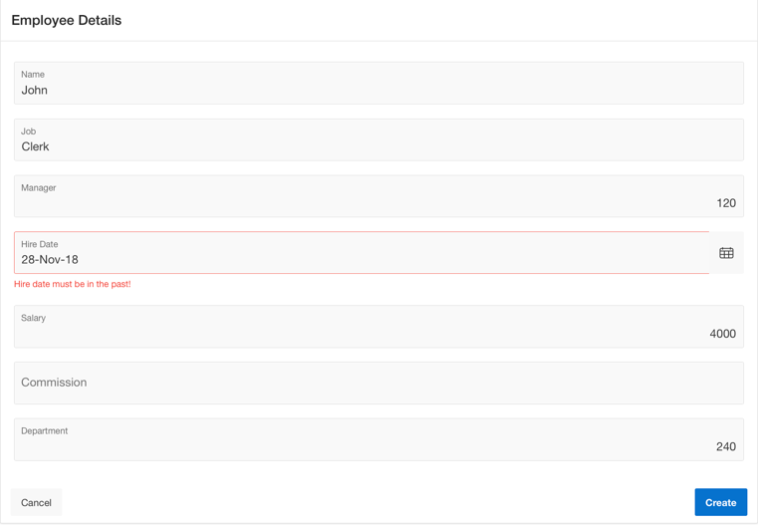
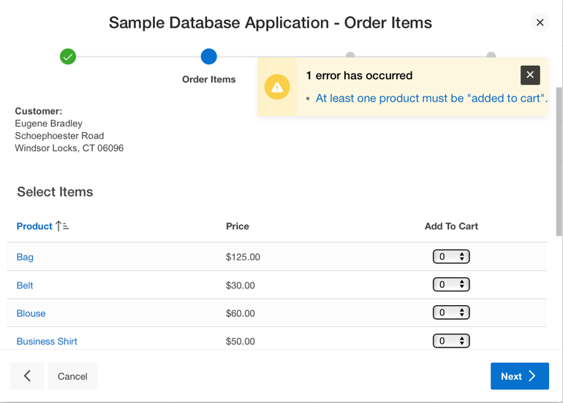
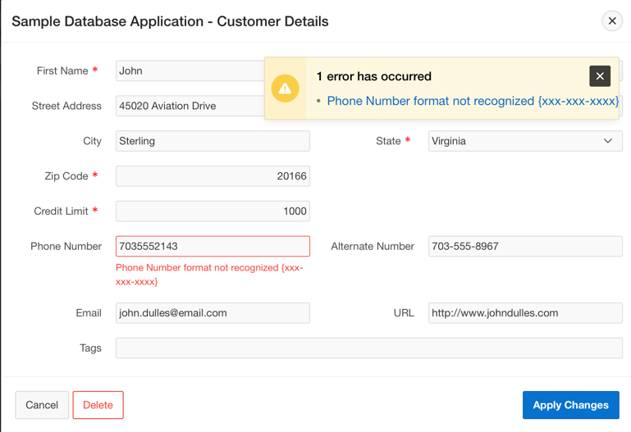
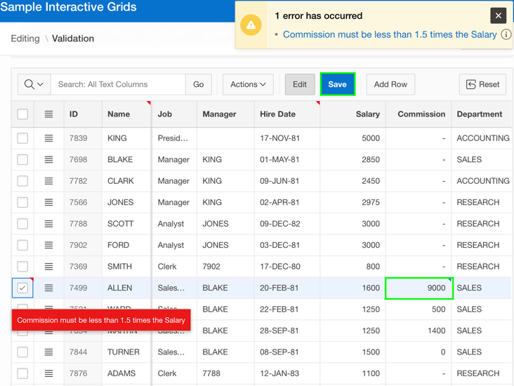
Understanding Validations
Notes:
A validation is an edit check. You use validations in your application form pages to ensure integrity of the data entered by users. Validations specific to a single item are page item validations. Validations that apply to an entire page are page validations. That is, page validations are validations that apply to one or more items simultaneously.
Examples:
Page Item Validation: Hire date in an employee details form must be in the past.
Page Validation: In a feedback application, feedback request date and the feedback closed date should be in chronological order. That is, the validation ensures feedback closed date is later than feedback request date.
You can define a validation declaratively by selecting a validation method. You enter the actual validation edit check in the Validation Messages field. The validation you enter must be consistent with the validation type you selected.
If a page is submitted and some of the validations fail, Oracle Application Express redisplays the existing page with all inline validation errors. While displaying inline errors, Oracle Application Express does not execute computations, application processes, or page processes (for example, Automated Row Fetch) which are defined to execute during Page Rendering (in other words, all "On Load %" display points). The one exception is if the computations and processes use the condition type Inline Validation Errors Displayed.
The reason for skipping these computations and processes is that any of they could potentially alter the data entered by the user. For example, an Automated Row Fetch process would fetch and overwrite the modified data with the values from the database when the user actually wants to get the entered data in order to fix the validation error.

Slide 16
Creating a Validation for a Page Item
View the page in page designer. Click the Processing tab in the left pane.
Right-click Validating and select Create Validation.
Under Validation, for Type, select the type of quality to be tested for this validation. Depending on your selection, one or more additional attributes are required to fully define this validation.
Specify the text for error message and select the display location.
Click Save.
Notes:
To create a validation in Page Designer, perform the following steps:
Click the Processing tab in the left pane. Right-click Validating and select Create Validation. Validation attributes display in the Property Editor. Attributes are organized in groups.
Edit the following attributes:
Identification >Name: Enter the name of the validation.
Execution Options > Sequence: Enter the sequence for this validation. The sequence determines the order of execution.
Validation > Editable Region: Select the associated region.
Validation >Type: Select the type of equality to be tested for this validation. Depending on your selection, one or more additional attributes are required to fully define this validation. If the validation passes the equality test, or evaluates to TRUE, then the validation error message does not display. Validation error messages display when the validation fails the equality test, or evaluates to FALSE, or a non-empty text string is returned.
Validation > Always Execute: Specify whether this validation always executes. If set to Yes, this validation is always evaluated, irrespective of the Execute Validations setting defined against the button that submitted the page. If set to No, this validation is only evaluated if the triggering button has an Execute Validations setting of Yes.
Error > Error Message: Enter text for the error message.
Error > Display Location: Select where the error message displays for this validation. Validation error messages display on a separate error page, or inline with the existing page. Inline error messages display underneath the Associated Item label and/or in a Notification area, defined as part of the page template.
Error > Associated Item/Column: Select the item or column where this validation error message displays. If you select an item and the Error message display location includes Inline with Field, the error message displays underneath the label of the specified item. If the Error message display location does not include Inline with Field, this attribute has no impact on the display of the error message.
Click Save.

Slide 17
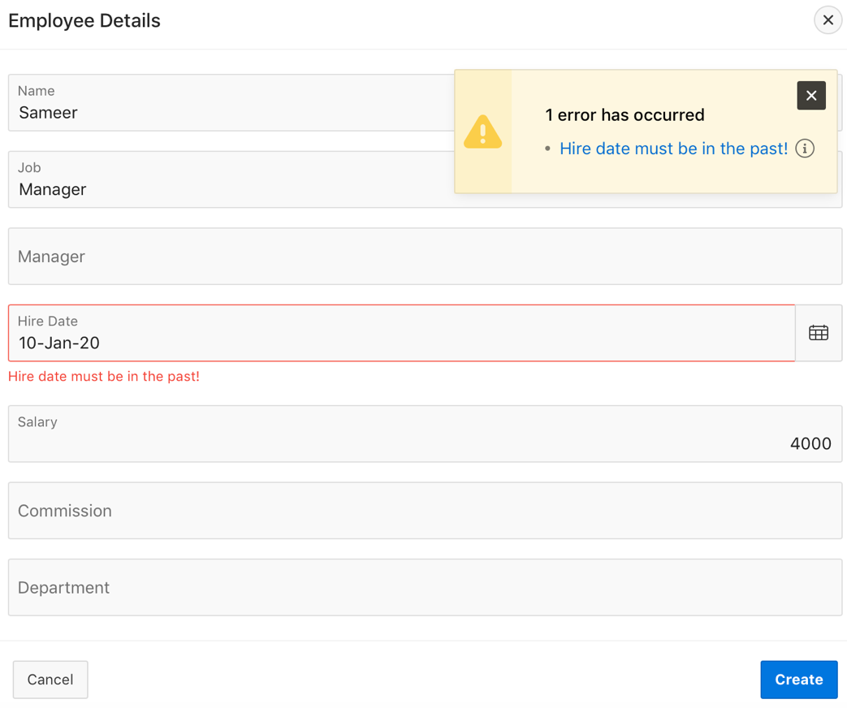
Creating a SQL Validation Type - Example
Create a Validation to ensure Hire Date is less than the current date.
Notes:
In the slide example, you create a validation to ensure that the value entered in the Hire Date field is less than the current date. You display the error message inline with the Hire Date field and in notification. In the next slide, you learn how to create this validation.

Slide 18
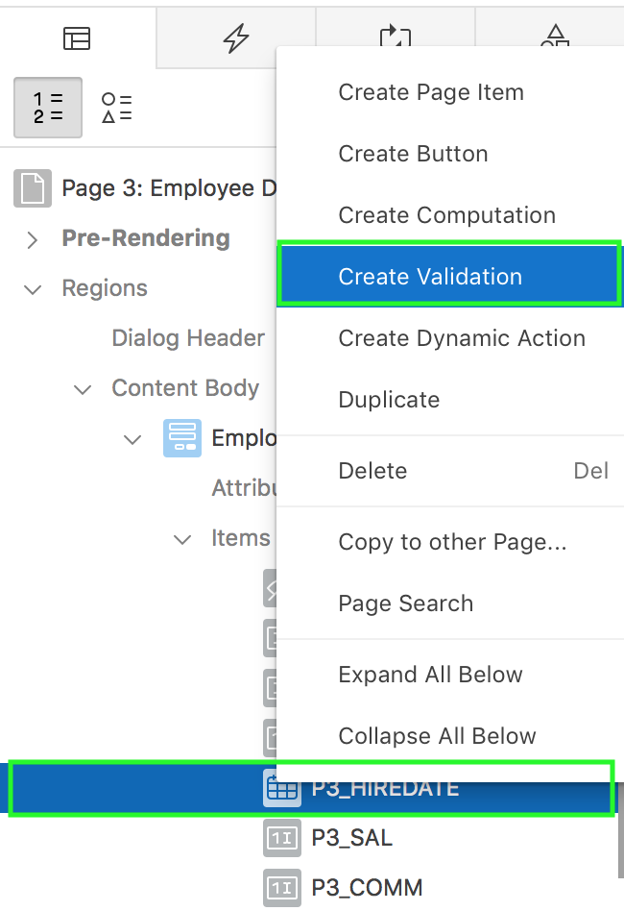
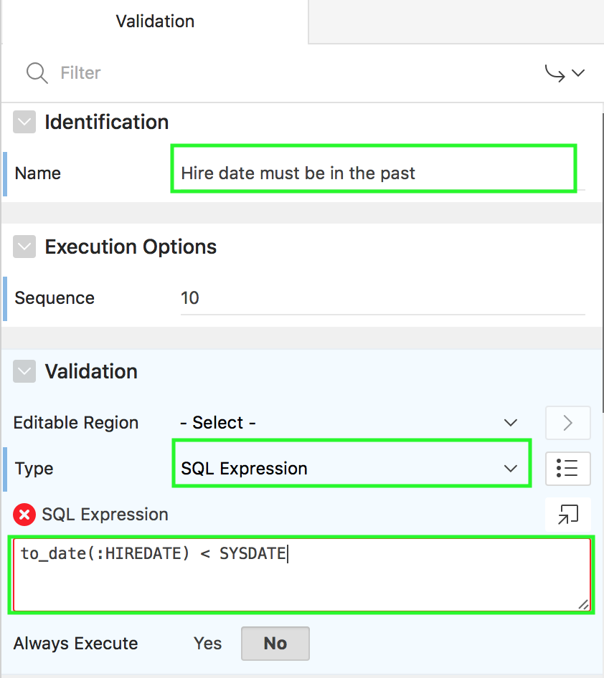
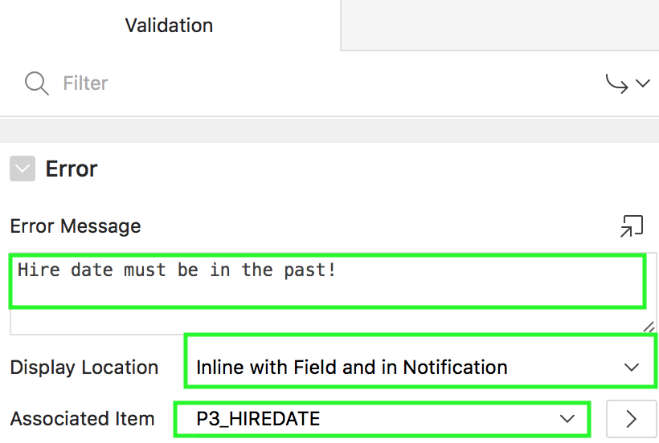
Creating a SQL Validation Type: Steps
Notes:
To create a SQL Validation, perform the following steps:
View your form page in page designer
In Rendering, expand items, select the page item on which you want to create the validation. Right click the page item and select Create Validation. Alternatively, select Processing, right-click Validating and select Create Validation. In the slide example, right-click P<n>_HIREDATE and select Create Validation.
Under Identification, enter a name for the validation.
Under Validation, select SQL Expression for validation type.
Under SQL Expression, enter your SQL. For example, in the slide, enter to_date(:HIREDATE) < SYSDATE
Under Error > Error Message, specify an error message.
Under Error > Display Location, select a location to display your message. You can also select the Associated Item from the select list.
Click Save.

Slide 19
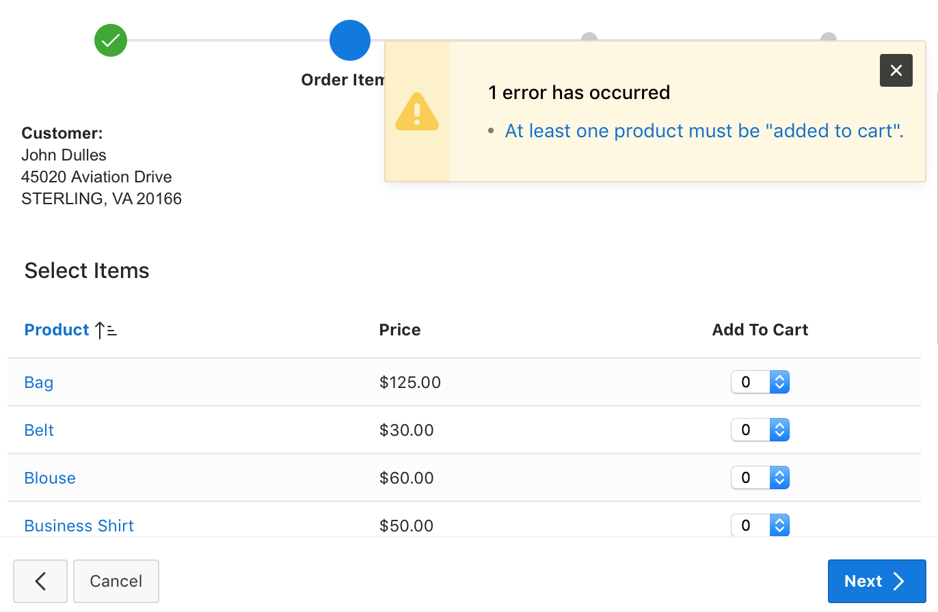
Creating a PL/SQL Validation Type - Example
Create a validation to ensure at least one product must be added to the cart to complete the order in the Place Order wizard.
Notes:
The slide example shows creating a validation in the Place Order wizard in the Sample Database Application. This PL/SQL validation ensures that at least one product must be added to the cart in order to complete the order.

Slide 20
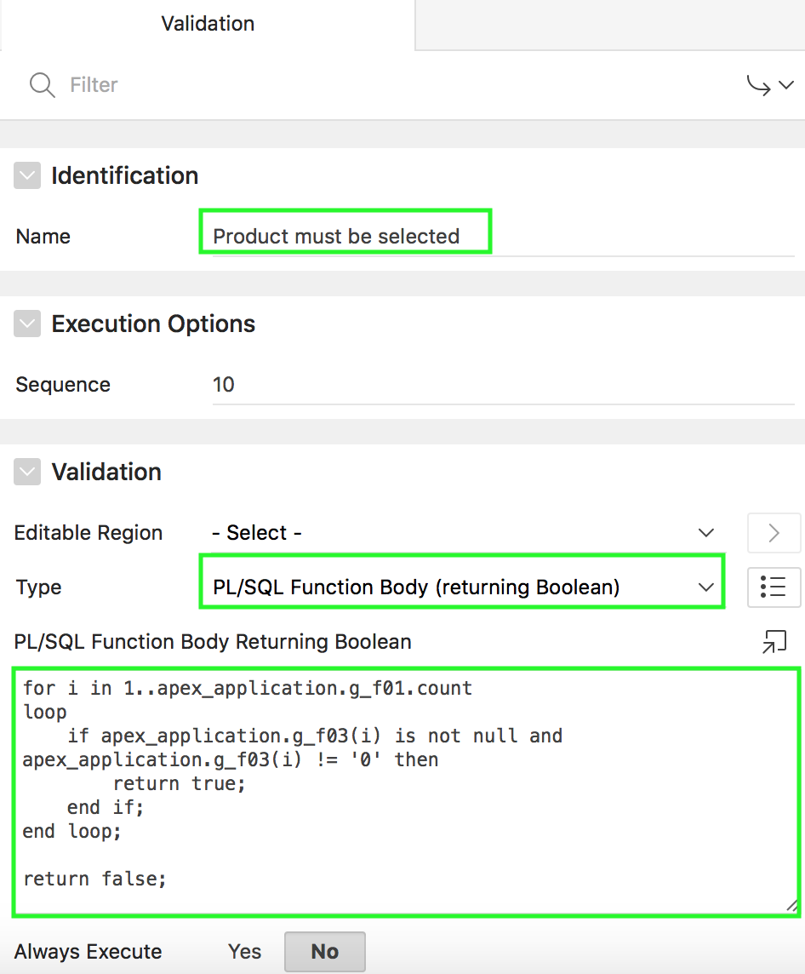
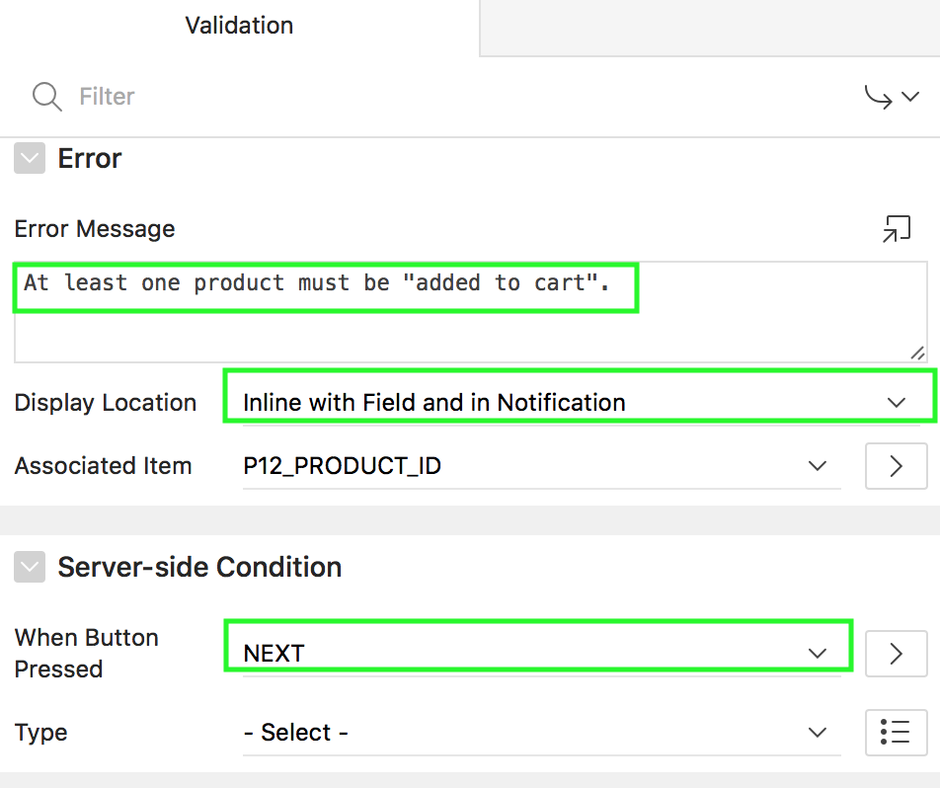
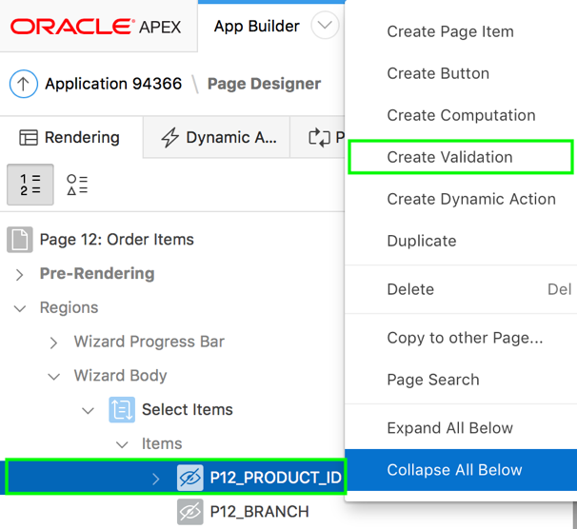
Creating a PL/SQL Validation Type: Steps
Notes:
To create a PL/SQL Validation, perform the following steps:
View your form page in page designer
In Rendering, expand items, select the page item on which you want to create the validation. Right click the page item and select Create Validation. Alternatively, click Processing, right-click Validating and select Create Validation. In the slide example, right-click P<n>_PRODUCT_ID and select Create Validation.
Under Identification, enter a name for the validation.
Under Validation, select PL/SQL Function Body (returning Boolean) for Type.
Enter your PL/SQL code.
Under Error > Error Message, specify an error message.
Under Error > Display Location, select a location to display your message.
Under Server-side Condition, for When Button Pressed, select a button from the list. In the slide example, you want the validation select to execute only when the NEXT button is clicked.
Click Save.

Slide 21
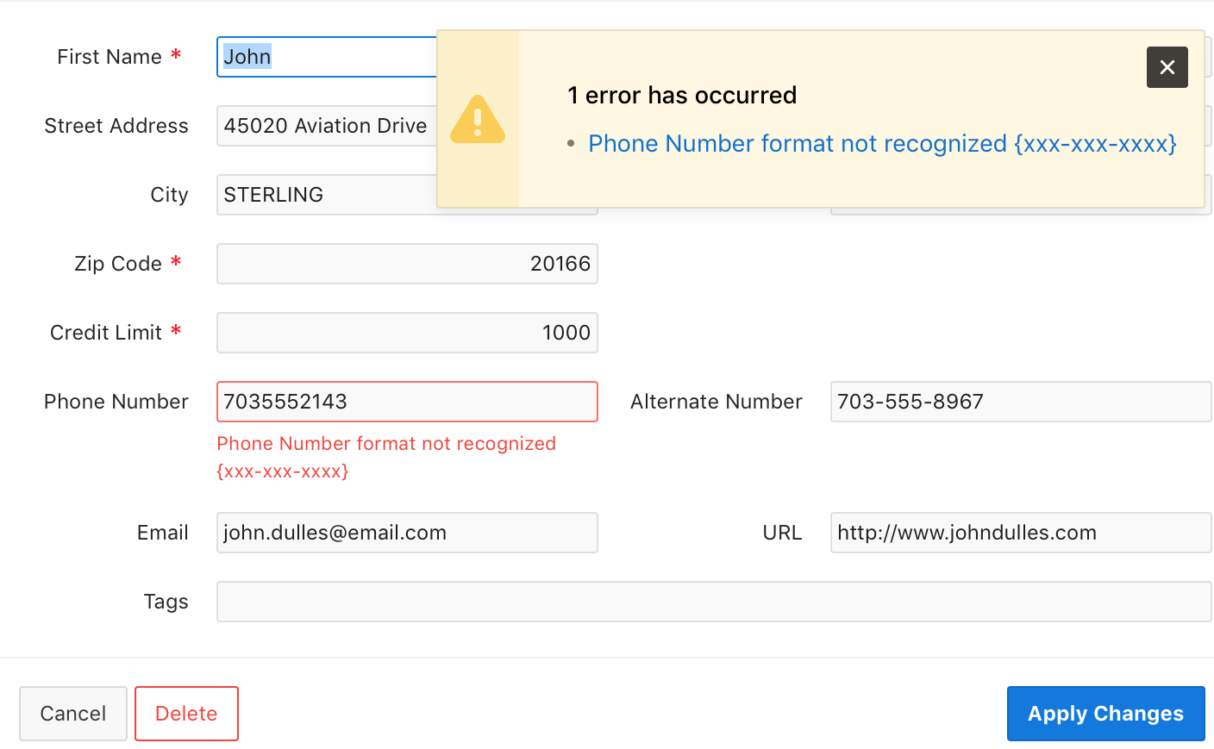
Creating a Regular Expression Validation Type - Example
Create a validation to ensure that the customer’s phone number entered is in the xxx-xxx-xxxx format.
Notes:
The slide example shows creating a validation on the Customer Details page. This validation ensures that the customer’s phone number entered is in the specified xxx-xxx-xxxx format. This regular expression validation throws an error if you enter the phone number in a format other than the recognized one.
Regular expressions enable you to search for patterns in string data by using standardized syntax conventions, rather than just a straight character comparisons.

Slide 22
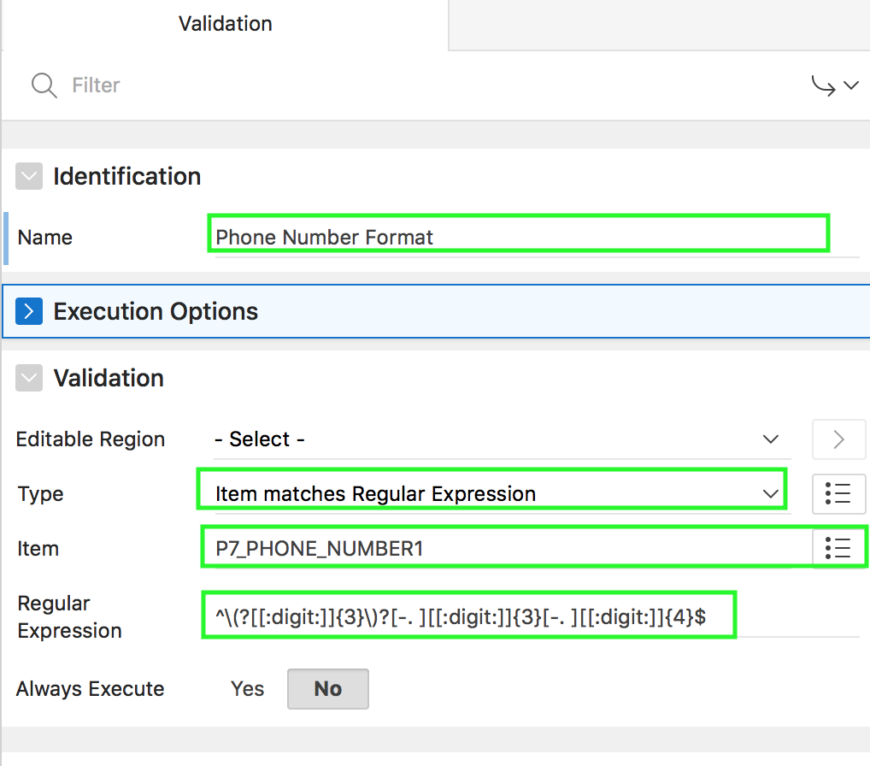
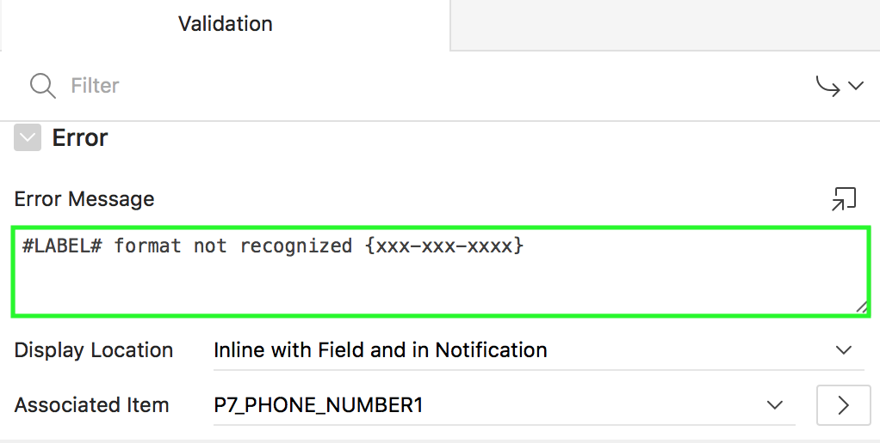
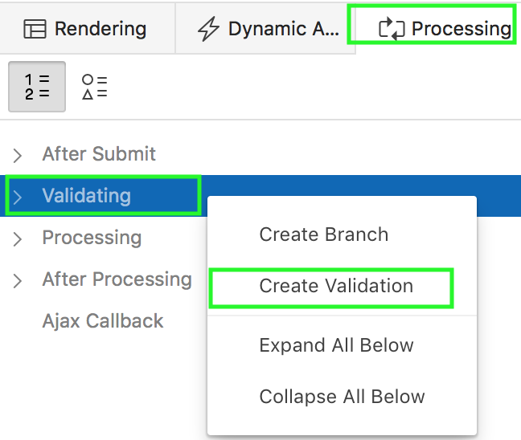
Creating a Regular Expression Validation Type: Steps
Notes:
To create a regular expression validation type, perform the following steps:
View your form page in page designer
In Rendering, expand items, select the page item on which you want to create the validation. Right click the page item and select Create Validation. Alternatively, click Processing, right-click Validating and select Create Validation.
Under Identification, enter a name for the validation.
Under Validation, select Item matches Regular Expression type.
For item, select the page item. In the slide example, select P<n>_PHONE_NUMBER1.
Enter the regular expression used to match the item specified for this validation.
Under Error > Error Message, specify an error message. In the slide example, you use #LABEL# as placeholder for the label of the associated page item.
Under Error > Display Location, select a location to display your message. Select the page item for Associated Item. For example, in the slide, ensure that P<n>_PHONE_NUMBER1 is selected.
Click Save.

Slide 23
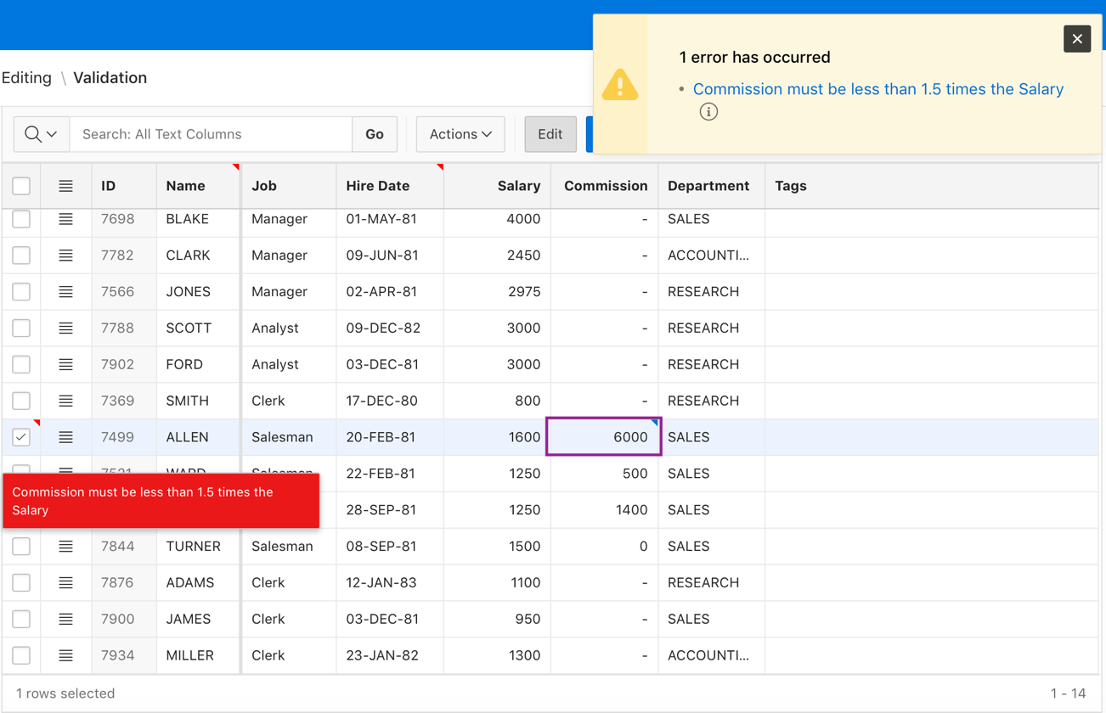
Creating a Row Validation in an Interactive Grid - Example
Create a row validation in an editable interactive grid region. This validation ensures commission is less than 1.5 times the salary.
Notes:
The slide example shows a row validation created in the Employees editable interactive grid. This validation ensures that the commission entered must be less than 1.5 times the salary value. In the next slide, you learn how to create a row validation.

Slide 24
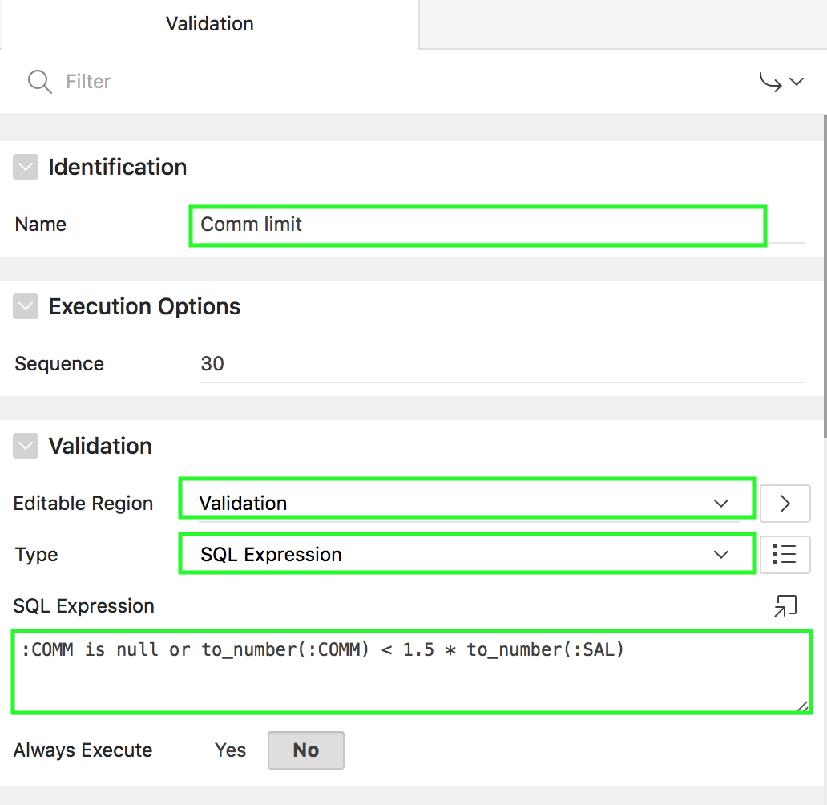
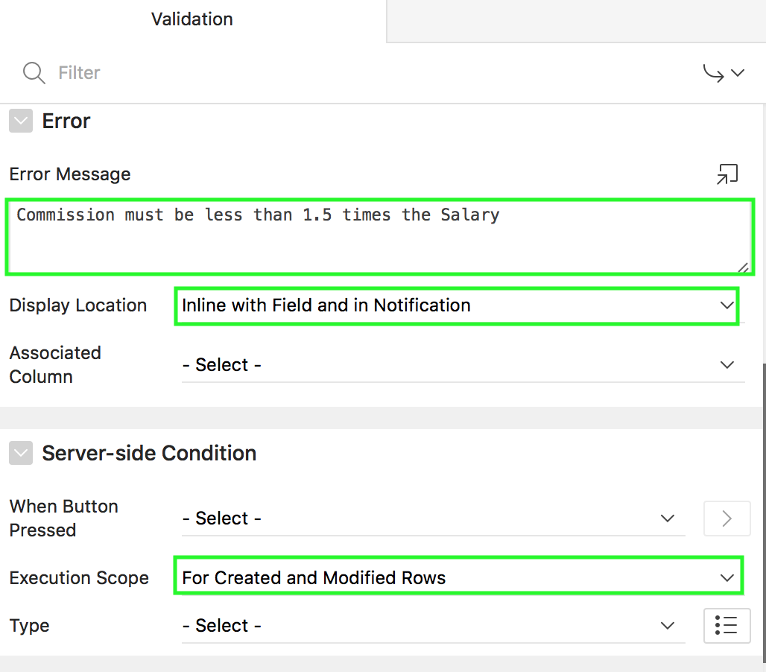
Creating a Row Validation in an Interactive Grid: Steps
Notes:
To add a row validation in an interactive grid, perform the following steps:
In page designer, click Processing. Right-click Validating and select Create Validation.
Under Identification, enter a name for the validation.
Under Validation, select a editable region. In the slide example, you select Validation editable region. Then, select a validation type. In the slide example, you select SQL Expression.
Enter the SQL Expression.
Under Error > Error Message, specify an error message.
Under Error > Display Location, select a location to display your message.
Under Server-side Condition, select an execution scope for this editable region validation. Select For Created and Modified Rows, if you want this validation to be evaluated for new and updated rows in your editable region. If you want your validation to be evaluated for every submitted row, select All Submitted Rows. In the slide example, you select For Created and Modified Rows.
Click Save.

Slide 25
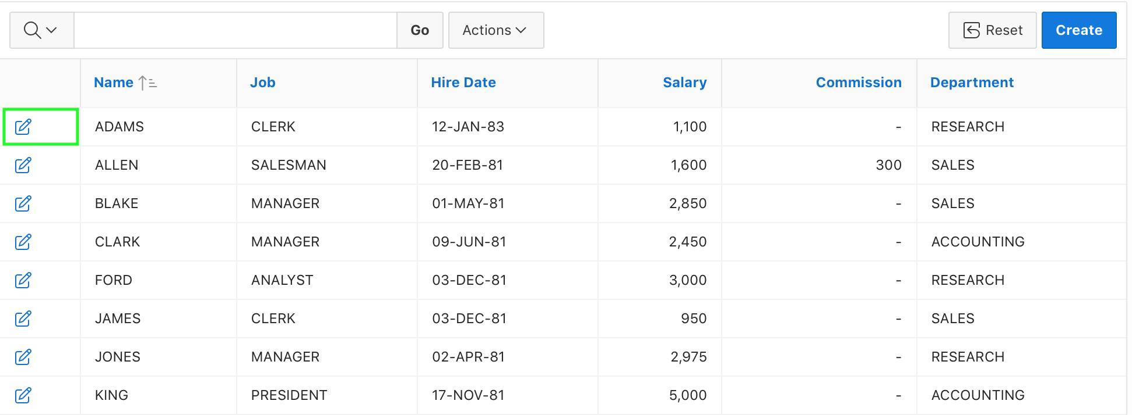
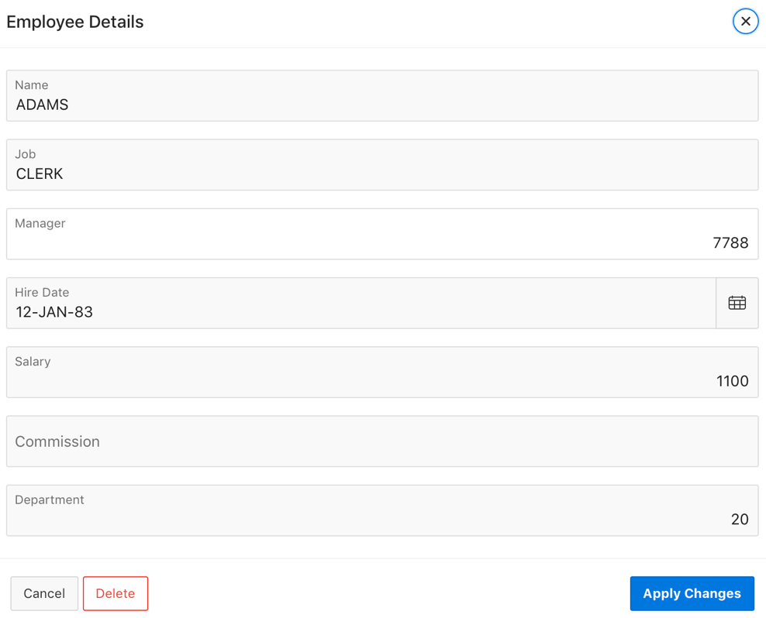
Understanding Branching
Page 1
Page 2
Page 2 is submitted and branched to Page 1
Notes:
A branch is an instruction to go to a specific page, procedure, or URL after a given page is submitted. For example, you can branch from page 2 to page 1 after page 2 is submitted. The slide shows a normal form (Page 2) is submitted and then is redirected to a report (Page 1). When you create a branch, you specify a Branch Point and Branch Type.
Note: For modal and non-modal pages close dialog is used instead of branches to return back to the calling page.

Slide 26
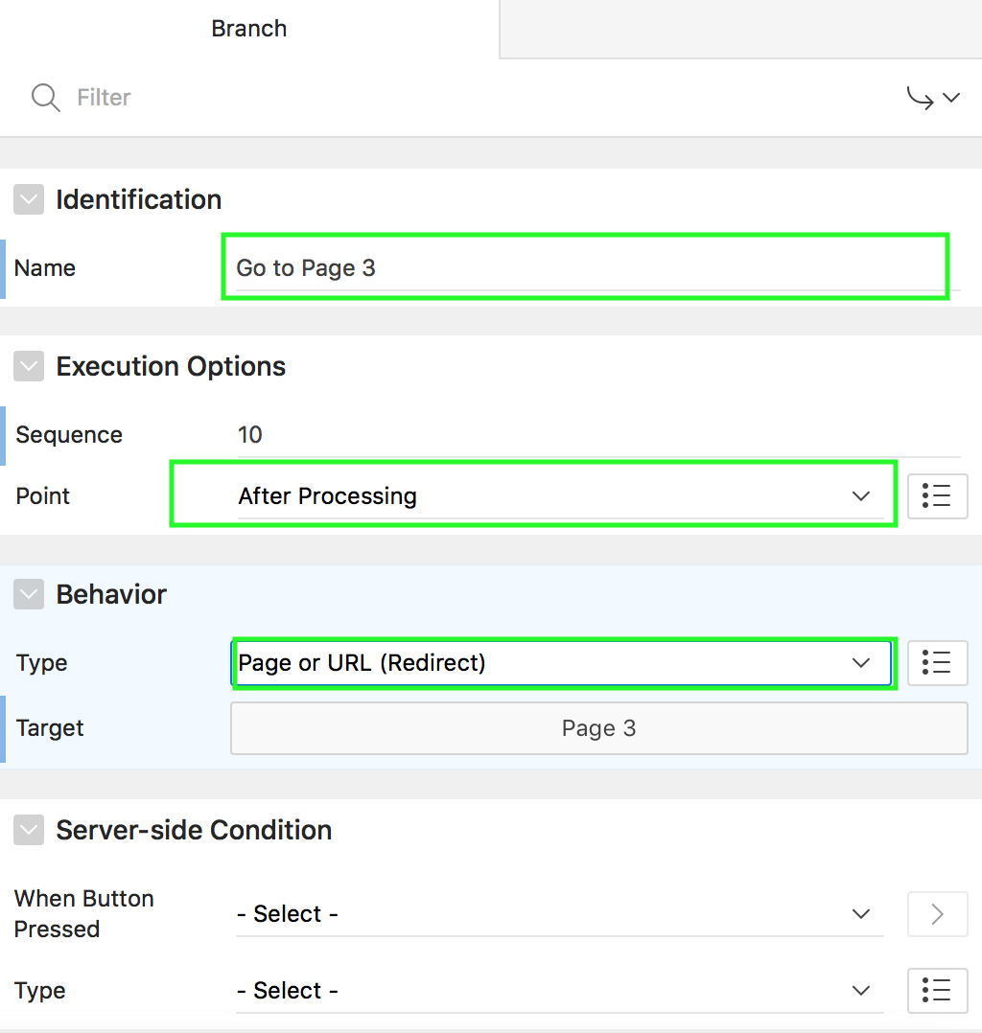
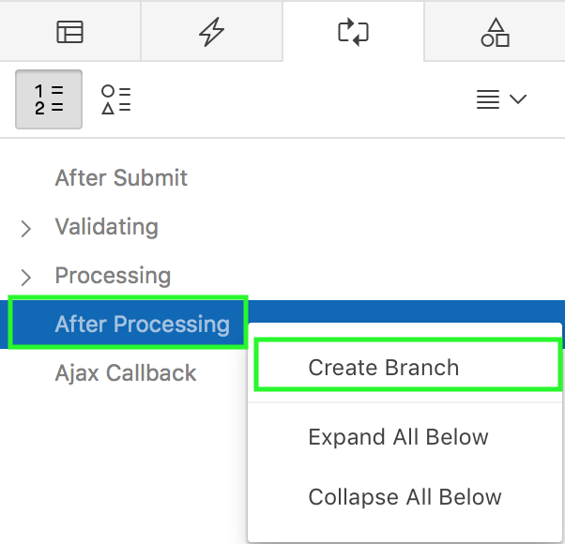
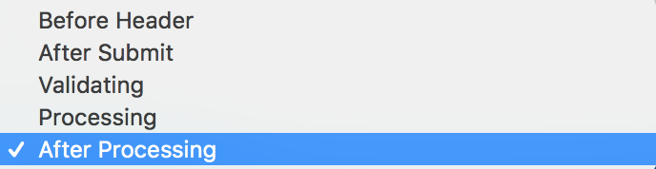
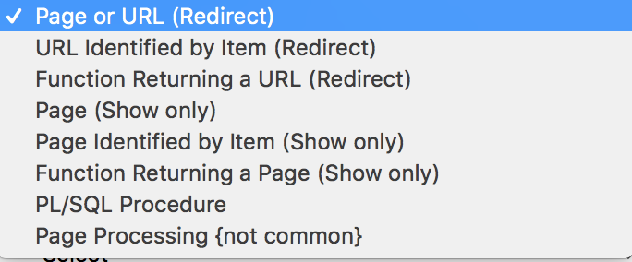
Creating a Branch
Specify branch point
Specify branch type
Notes:
To create a branch, perform the following steps:
View the page in page designer. Click Processing.
Select a branch point. Right-click and select Create Branch. For example, in the slide, right-click After Processing and click Create Branch. The Property Editor displays the Branch attributes.
In the Branch property editor, specify a name for the branch. Under Execution Options, select the branch point. Select the point in the processing at which this branch action is considered. The slide example shows the options included.
Under Behavior, specify the branch type and then target.
Under Server-side condition, you can also specify conditions if any. If you want this page processing component to execute only when the specified button is clicked, select a button from the list. You can incorporate this button condition with other conditions to further refine when this page processing component executes.
Click Save.

Slide 27
Summary
In this lesson, you learned how to create :
Computations
Processes
Validations
Branches

Slide 28


Slide 29
Hands-on Lab

